Slide 1
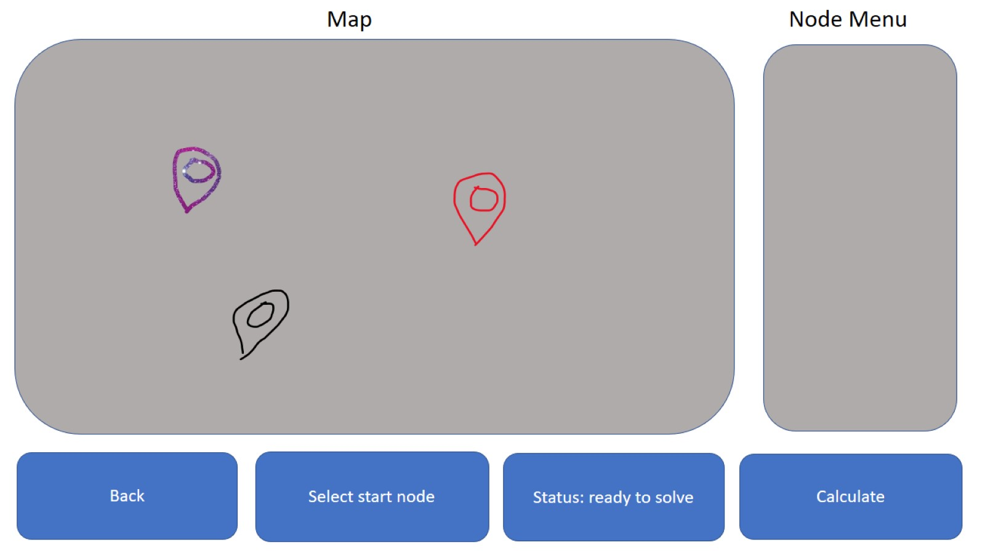
Node 1
delete
rename
Node 2
delete
rename
Node 3
delete
rename

Slide 2
Previous solutions
Route name
Map displaying route
Route 3
select
delete
rename
Route 2
select
delete
rename
Back
Clear all
solutions

Slide 3
Travelling salesman
applied to google maps
Start new
route
View previous
routes

